Slide 1
Python Class 11 Series
Problem Solving
Saroj Kumar Jha
Saroj Codes
Please subscribe

Slide 2
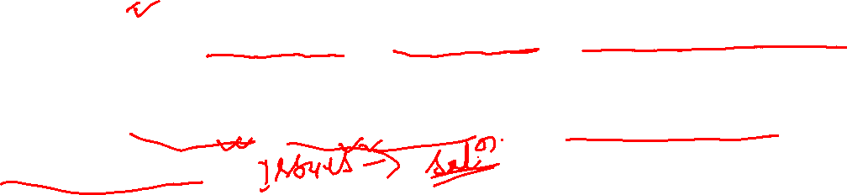
Problem solving is a fundamental cognitive process that involves finding solutions to complex or challenging issues. It is a skill that humans have relied on throughout history to overcome obstacles, achieve goals, and make progress in various domains.
At its core, problem solving entails analyzing a problem, identifying potential solutions, evaluating their effectiveness, and implementing the most suitable course of action. It requires critical thinking, creativity, logical reasoning, and often involves a systematic approach to arrive at the best possible outcome.

Slide 3
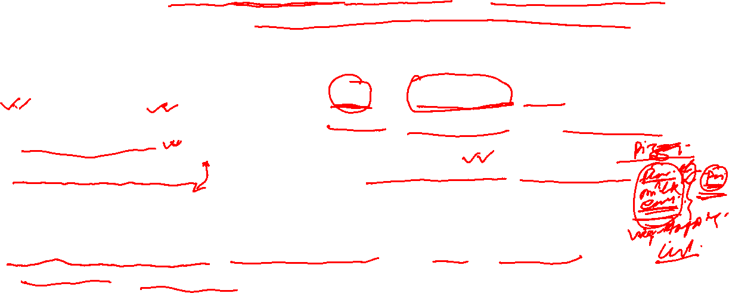
Step 1-> Analysing the problem:
Remember that the analysis phase is not only about finding the solution but also about developing a comprehensive understanding of the problem. A well-analyzed problem sets the foundation for a more informed and successful problem-solving process.
Clarify the Problem Statement: Ensure you have a clear and concise problem statement. Identify what needs to be solved and what the desired outcome is.
Gather Information: Collect all relevant data and information related to the problem. This may involve conducting research, gathering data, or seeking input from stakeholders.
Identify the Root Cause: Try to identify the underlying causes of the problem. Determine what factors contribute to the issue to avoid addressing only the symptoms.
Break Down the Problem: Divide the problem into smaller, manageable components or sub-problems. This allows for a more systematic and focused analysis.

Slide 4
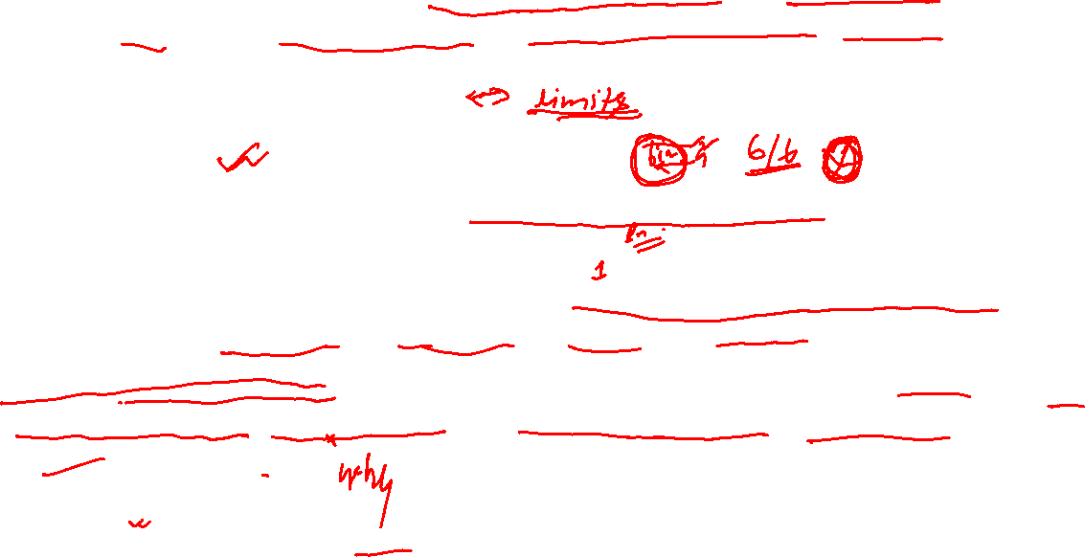
Explore Different Perspectives: Consider the problem from different angles and perspectives. Seek input from others who may have diverse viewpoints.
Examine Constraints and Limitations: Identify any constraints or limitations that may affect the solution. These could be resource constraints, time constraints, or external factors.
Determine the Impact: Assess the consequences of the problem. Understand who is affected by it and to what extent.
Consider Previous Solutions: Look into past attempts to solve similar problems. Learn from past successes and failures to inform your approach.
Use Problem-Solving Tools: Employ problem-solving techniques and tools, such as root cause analysis, SWOT analysis, or the 5 Whys method, to gain deeper insights.
Ask Questions: Ask probing questions to gain a comprehensive understanding of the problem. Keep asking "why" to uncover deeper layers of causation.

Slide 5

Define Success Criteria: Determine how you will measure the success of your solution. Establish specific criteria to evaluate the effectiveness of the chosen approach.
Prioritize and Focus: Identify the most critical aspects of the problem and prioritize them. This helps in allocating resources and attention more effectively.
STEP 2: Developing an Algorithm
Remember, developing an algorithm is an iterative process, and it may take several iterations to reach an optimal and efficient solution. The algorithm's effectiveness depends on how well it addresses the problem and how efficiently it performs its intended task.
Understand the Problem: Begin by thoroughly understanding the problem you need to solve. Define the problem's input, expected output, and any constraints or limitations.
Identify the Steps: Break down the problem into smaller, manageable steps or subtasks. Consider the sequence in which these steps need to be executed.

Slide 6
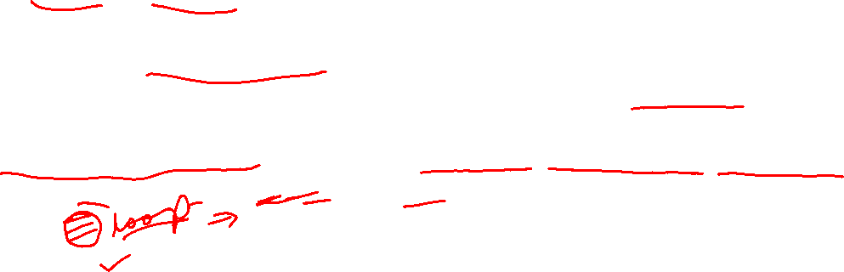
Specify Inputs and Outputs: Clearly define the inputs required by the algorithm to perform the task and the expected outputs it should produce.
Choose Appropriate Data Structures: Determine the data structures (e.g., arrays, lists, dictionaries) needed to store and manipulate data during the algorithm's execution.
Design Logic and Control Flow: Develop the logic and control flow for the algorithm. Use conditional statements (e.g., if, else) and loops (e.g., for, while) to control the flow of execution.
Address Error Handling: Consider potential errors or unexpected scenarios that may arise during the algorithm's execution. Implement error handling techniques to handle these cases gracefully.
Test and Verify: Simulate the algorithm with sample inputs to ensure it produces the correct outputs. Verify its correctness and efficiency.
Optimize (if needed): Analyze the algorithm's performance and identify opportunities for optimization, if required, to reduce time or space complexity.

Slide 7
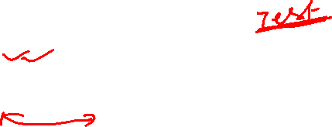
Document the Algorithm: Write detailed comments and documentation to explain the purpose, logic, and steps of the algorithm. This will make it easier for others to understand and maintain.
Iterate and Improve: If the algorithm does not meet the desired requirements, revise and refine the steps until the desired outcome is achieved.
Implement the Algorithm: Translate the algorithm into the programming language of your choice to create a working solution.
Test Thoroughly: Test the implemented algorithm with various test cases to ensure its correctness and robustness.
STEP 3: Coding
Coding, also known as programming, is the process of writing instructions for a computer to execute. These instructions are written in a programming language that the computer can understand and follow. Coding is the fundamental skill used to develop software, applications, websites, and other digital solutions. Here are the key steps involved in coding:

Slide 8
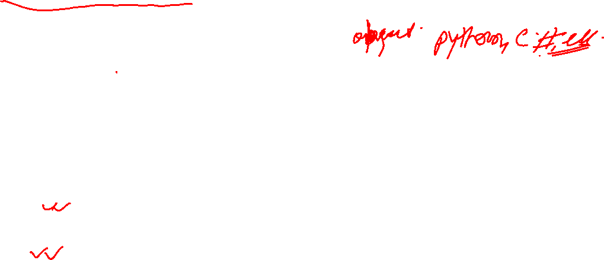
Choose a Programming Language: Select a programming language suitable for the task at hand. Programming languages have different syntax and capabilities, so choose one that best aligns with your project's requirements.
Understand the Problem: Before writing any code, thoroughly understand the problem you are trying to solve or the task you need to accomplish. Analyze the requirements and plan how to approach the solution.
Plan the Logic: Design the logic and flow of your program. Break down the problem into smaller steps and determine how the program will handle various situations and inputs.
Write the Code: Start writing the code based on the logic and plan you have developed. Implement the algorithms and instructions to achieve the desired outcome.
Test the Code: After writing a section of code or completing the program, test it thoroughly with various test cases to ensure it behaves as expected and produces the correct output.
Debugging: If any errors or bugs are encountered during testing, use debugging techniques to identify and fix the issues in the code.

Slide 9
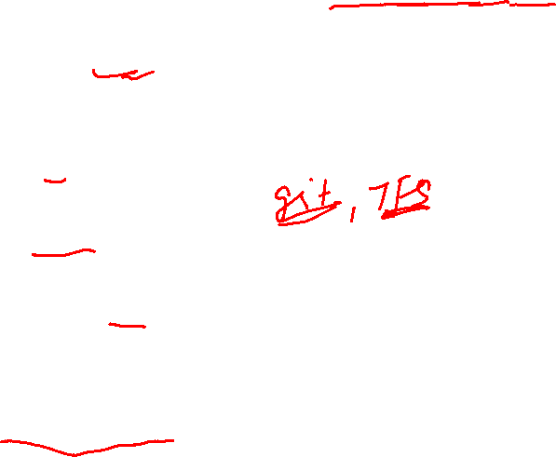
Optimize (if needed): Analyze the code's performance and identify opportunities for optimization to make it more efficient and responsive.
Document the Code: Include comments and documentation in the code to explain the purpose of each section, provide clarity to others (or even yourself in the future), and make the code maintainable.
Version Control: Use version control systems (e.g., Git) to track changes and manage different versions of your code.
Deploy the Code: Once the code is fully tested and meets the requirements, deploy it to the intended environment (e.g., a web server, application store, etc.).
Maintain and Update: Keep the code updated and maintain it over time to address new requirements or fix issues that may arise.
STEP 4 : Testing and Debugging
Testing and debugging are crucial stages in the software development process. They help ensure that the code works as intended, is free from errors, and meets the required specifications. Here's an overview of testing and debugging:

Slide 10
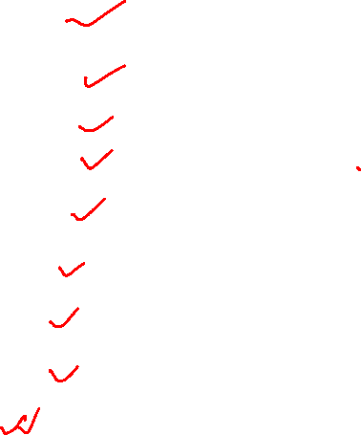
Testing:
Unit Testing: Test individual units or components of the code in isolation. It helps identify issues in specific functions or modules.
Integration Testing: Test how different units work together and interact. Ensure that the integration of components does not introduce unexpected errors.
Functional Testing: Verify if the software performs as expected and meets the functional requirements.
Regression Testing: Re-test the software after making changes or adding new features to ensure that the existing functionalities still work correctly.
User Acceptance Testing (UAT): Have end-users or clients test the software to ensure it meets their needs and requirements.
Performance Testing: Evaluate the software's responsiveness and stability under various loads and stress conditions.
Security Testing: Check for vulnerabilities and potential security breaches to protect against potential threats.
Automated Testing: Use testing tools and scripts to automate repetitive tests and streamline the testing process.
Debugging:
Identify the Issue: When a bug is encountered, try to reproduce it consistently and determine the exact conditions under which it occurs.
Use Debugging Tools: Utilize debugging tools provided by the programming environment to inspect the code's execution and variables at runtime.
Print Statements: Insert print statements strategically in the code to track the flow and values of variables during execution.
Binary Search Method: In large codebases, use a binary search approach to narrow down the location of the bug by selectively disabling code sections.
Rubber Duck Debugging: Explain the code and the problem to an inanimate object or a colleague. Often, the act of explaining can lead to identifying the issue.
Fix the Bug: Once the bug is identified, implement the necessary changes to fix the issue.
Retest: After fixing the bug, retest the software to ensure that the issue is resolved without introducing new problems.

Slide 11
Debugging:
Identify the Issue: When a bug is encountered, try to reproduce it consistently and determine the exact conditions under which it occurs.
Use Debugging Tools: Utilize debugging tools provided by the programming environment to inspect the code's execution and variables at runtime.
Print Statements: Insert print statements strategically in the code to track the flow and values of variables during execution.
Binary Search Method: In large codebases, use a binary search approach to narrow down the location of the bug by selectively disabling code sections.
Rubber Duck Debugging: Explain the code and the problem to an inanimate object or a colleague. Often, the act of explaining can lead to identifying the issue.
Fix the Bug: Once the bug is identified, implement the necessary changes to fix the issue.
Retest: After fixing the bug, retest the software to ensure that the issue is resolved without introducing new problems.

Slide 12
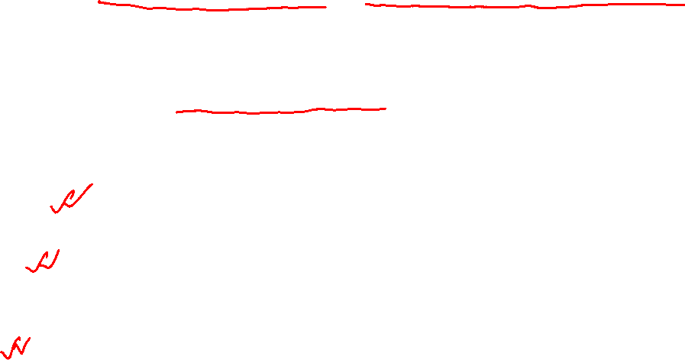
ALGORITHM
An algorithm is a step-by-step procedure or a well-defined set of instructions used to solve a specific problem or perform a particular task. Algorithms can be implemented using various programming languages to achieve the desired outcome.
Characteristics of a good algorithm
A good algorithm exhibits several important characteristics that make it efficient, reliable, and practical for solving a specific problem. Here are the key characteristics of a good algorithm:
Correctness: A good algorithm should produce the correct output for all possible valid inputs. It should accurately solve the problem it was designed for without errors.
Efficiency: An efficient algorithm executes with the optimal use of resources (time and memory). It should complete the task within a reasonable time and not waste unnecessary computational resources.
Clarity: A good algorithm should be clear and easy to understand. It should have a well-defined structure, use meaningful variable names, and be organized in a logical manner.

Slide 13
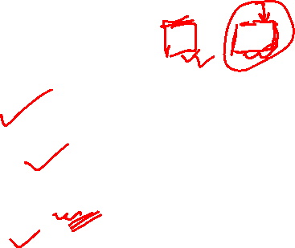
Modularity: An algorithm should be modular, meaning it can be divided into smaller, manageable components. Each component should perform a specific sub-task, making the algorithm easier to comprehend, maintain, and reuse.
Finiteness: A good algorithm should have a well-defined termination point, meaning it will eventually halt and produce the output after a finite number of steps.
Input and Output: The algorithm should clearly define its input requirements and the format of the output it produces. It should handle valid inputs gracefully and account for invalid inputs with appropriate error handling.
Generalization: An ideal algorithm is designed to solve a specific problem but can be generalized to handle similar problems and scenarios.
Robustness: A robust algorithm should be able to handle unexpected or invalid inputs without crashing or producing incorrect results. It should include error handling and appropriate fallback mechanisms.
Independence of Language or Platform: A good algorithm is independent of the programming language or platform used for its implementation. It should be applicable across different environments.
Optimality: In some cases, an optimal algorithm finds the best possible solution efficiently. However, optimization may not be required for all problems, depending on the scale and complexity.
Well-Tested: A good algorithm should be thoroughly tested with various test cases to ensure its correctness and robustness.
Maintainability: An algorithm should be easy to modify or extend as requirements change over time.

Slide 14
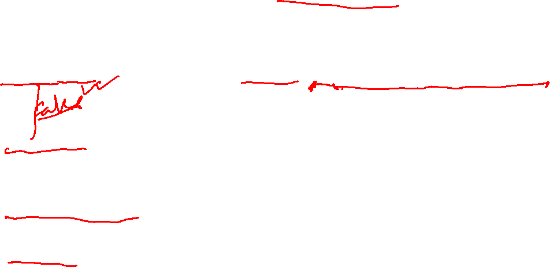
REPRESENTATION OF ALGORITHMS
Algorithms can be represented in various ways to convey their logical steps and execution flow. The common representations of algorithms include:
Pseudocode: Pseudocode is an informal, human-readable representation of an algorithm that uses a combination of natural language and programming constructs. It helps in understanding the logic without being tied to a specific programming language syntax.
Flowcharts: Flowcharts use symbols and arrows to visually represent the logical flow and sequence of steps in an algorithm. They are particularly useful for understanding the control flow and decision-making processes.
Structured English: Structured English is a way of representing algorithms using standard English with well-defined structures, such as sequence, selection, and iteration.
Nassi-Shneiderman Diagrams: These diagrams are similar to flowcharts and represent the control flow using structured elements such as sequence, selection, and iteration constructs.
Control Tables: Control tables use tabular representation to define a sequence of actions based on different conditions or inputs.

Slide 15
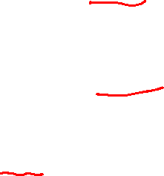
REPRESENTATION OF ALGORITHMS
Decision Tables: Decision tables are used to represent complex conditions and outcomes in a tabular form, making it easier to handle multiple scenarios.
Structured Charts: Structured charts combine elements of flowcharts, Nassi-Shneiderman diagrams, and control tables to represent the hierarchy of processes and control flow in an algorithm.
Unified Modeling Language (UML) Activity Diagrams: UML activity diagrams are a graphical representation used in software engineering to model the workflow of an algorithm or system.
Data Flow Diagrams (DFD): DFDs represent the flow of data within an algorithm or system and help in understanding data transformations and processing steps.
State Diagrams: State diagrams represent the different states an algorithm or system can be in and how it transitions between these states based on inputs or events.

Slide 16
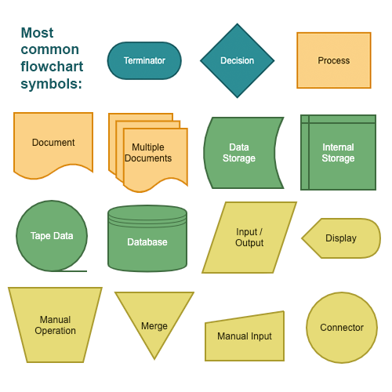
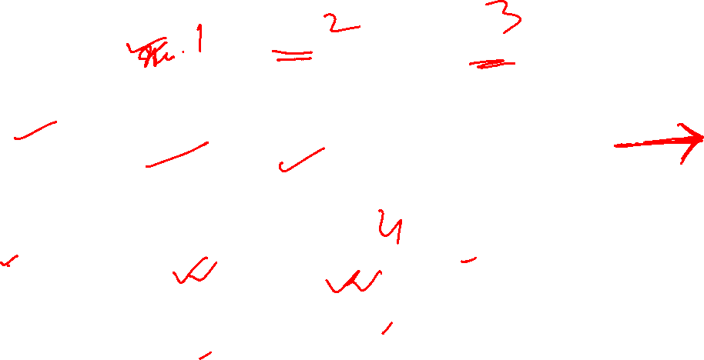
REPRESENTATION OF ALGORITHMS

Slide 17
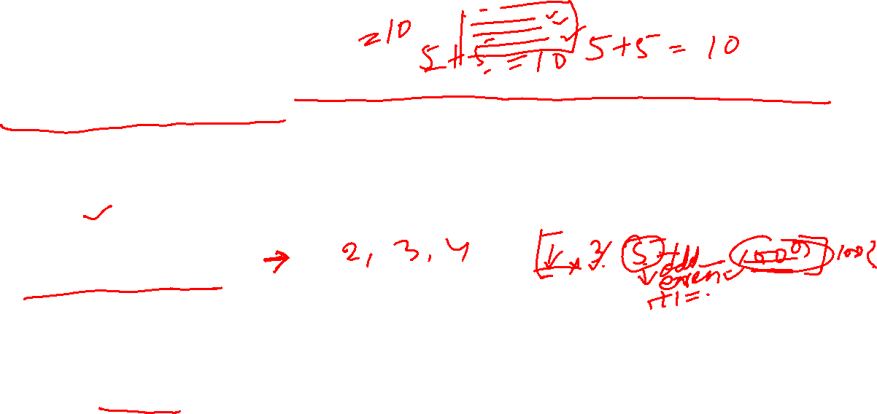
FLOW OF CONTROL
The flow of control refers to the order in which the instructions or statements in a program are executed during its runtime. The flow of control is determined by the program's control structures, which dictate the sequence of operations based on certain conditions or loops. There are three main types of flow control in programming:
Sequence: In a sequence, the statements are executed one after the other in the order they appear. This is the default flow of control, and most programs start with a sequence of statements.
Selection (Conditional): Selection controls allow the program to make decisions based on certain conditions. It uses conditional statements like "if," "else if," and "else" to determine which block of code should be executed based on whether a condition is true or false.
Iteration (Looping): Iteration controls allow the program to repeat a block of code multiple times until a certain condition is met. It uses loop statements like "for," "while," and "do-while" to execute a section of code repeatedly.

Slide 18
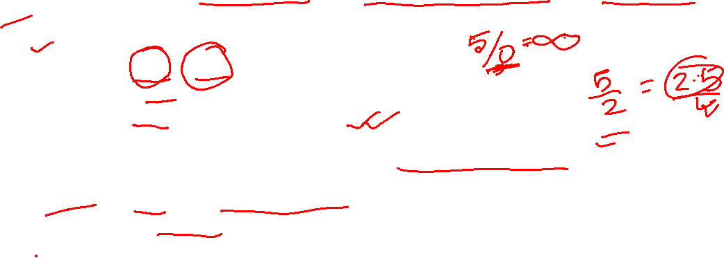
Question Answer
Write pseudocode that reads two numbers and divide one by another and display the quotient
1. Start
2. Declare variables num1, num2, quotient
3. Read the value of num1 from the user
4. Read the value of num2 from the user
5. Check if num2 is not equal to 0 (to avoid division by zero)
a. If num2 is equal to 0, display an error message "Cannot divide by zero."
b. If num2 is not equal to 0, continue to the next step.
6. Divide num1 by num2 and store the result in the variable quotient
7. Display the value of quotient
8. End

Slide 19
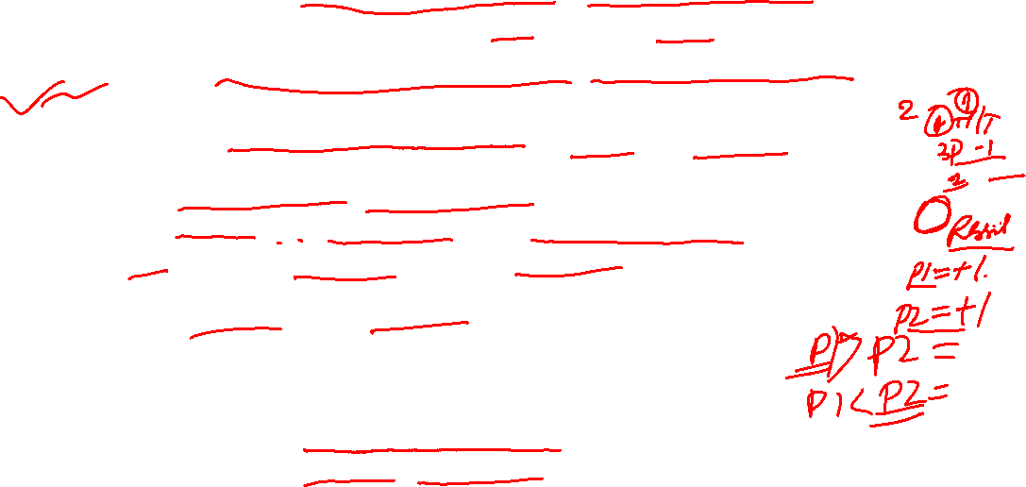
Question Answer
Two friends decide who gets the last slice of a cake by flipping a coin five times. The first person to win three flips wins the cake. An input of 1 means player 1 wins a flip, and a 2 means player 2 wins a flip. Design an algorithm to determine who takes the cake
Start
Initialize variables to keep track of the number of wins for player 1 and player 2 (let's call them player1Wins and player2Wins) and set both to 0.
Repeat the following steps five times (for five coin flips):
Read the result of the coin flip (1 for player 1 wins, 2 for player 2 wins).
If the result is 1, increment player1Wins by 1. If the result is 2, increment player2Wins by 1.
Check the values of player1Wins and player2Wins.
If player1Wins is greater than or equal to 3, player 1 wins the cake.
If player2Wins is greater than or equal to 3, player 2 wins the cake.
If neither player has won three flips yet, go back to step 3 for the next coin flip.
If player 1 wins the cake, display "Player 1 wins the cake!"
If player 2 wins the cake, display "Player 2 wins the cake!"
End

Slide 20
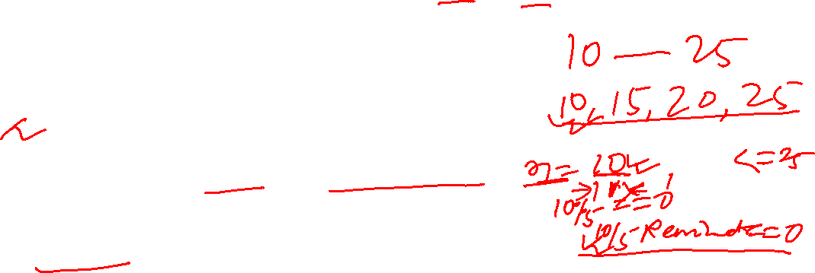
Question Answer
Write the pseudocode to print all multiples of 5 between 10 and 25 (including both 10 and 25).
// Pseudocode to print all multiples of 5 between 10 and 25 (inclusive)
1. Start
2. Set a variable 'number' to 10
3. Repeat the following steps until 'number' is less than or equal to 25:
a. Check if 'number' is a multiple of 5 (i.e., 'number' % 5 equals 0)
b. If 'number' is a multiple of 5, print its value
c. Increment 'number' by 1
4. End

Slide 21
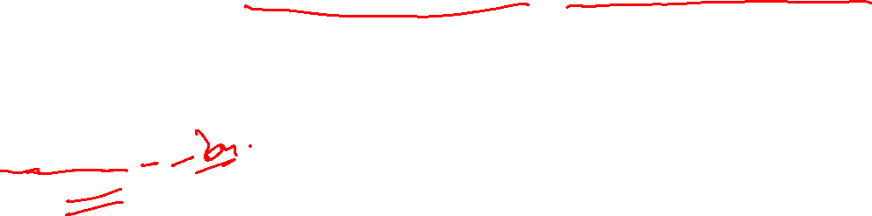
Question Answer
Give an example of a loop that is to be executed a certain number of times.
# Example of a loop executed a certain number of times
for i in range(1, 6):
print(i)

Slide 22
Question Answer
Suppose you are collecting money for something. You need ` 200 in all. You ask your parents, uncles and aunts as well as grandparents. Different people may give either ` 10, ` 20 or even ` 50. You will collect till the total becomes 200. Write the algorithm.
Start
Initialize a variable 'totalAmount' to 0 to keep track of the total collected amount.
Repeat the following steps until 'totalAmount' becomes equal to or greater than 200:
a. Ask a person to contribute (10, 20, or 50).
b. Read the contributed amount from the person.
c. Add the contributed amount to 'totalAmount'.
End the loop.
Display "Total collected amount: `totalAmount".
End.

Slide 23
Question Answer
Write the pseudocode to print the bill depending upon the price and quantity of an item. Also print Bill GST, which is the bill after adding 5% of tax in the total bill
// Pseudocode to calculate and print the bill with GST
1. Start
2. Declare variables 'price', 'quantity', 'totalBill', 'gstAmount'
3. Read the 'price' of the item from the user
4. Read the 'quantity' of the item from the user
5. Calculate the 'totalBill' as the product of 'price' and 'quantity'
6. Calculate the 'gstAmount' as 5% of the 'totalBill'
7. Add 'gstAmount' to 'totalBill' to get the final bill with GST
8. Print "Item Price: 'price'"
9. Print "Quantity: 'quantity'"
10. Print "Total Bill: 'totalBill'"
11. Print "Bill GST: 'gstAmount'"
12. Print "Final Bill with GST: 'totalBill' + 'gstAmount'"
13. End

Slide 24
Question Answer
Write pseudocode that will perform the following:
a) Read the marks of three subjects: Computer Science, Mathematics and Physics, out of 100
b) Calculate the aggregate marks
c) Calculate the percentage of marks
1. Start
2. Declare variables 'computerScienceMarks', 'mathematicsMarks', 'physicsMarks', 'totalMarks', 'aggregateMarks', 'percentage'
3. Read 'computerScienceMarks' from the user
4. Read 'mathematicsMarks' from the user
5. Read 'physicsMarks' from the user
6. Set 'totalMarks' to 300 (since each subject has a maximum of 100 marks)
7. Calculate 'aggregateMarks' as the sum of 'computerScienceMarks', 'mathematicsMarks', and 'physicsMarks'
8. Calculate 'percentage' as ('aggregateMarks' / 'totalMarks') * 100
9. Print "Computer Science Marks: 'computerScienceMarks'"
10. Print "Mathematics Marks: 'mathematicsMarks'"
11. Print "Physics Marks: 'physicsMarks'"
12. Print "Aggregate Marks: 'aggregateMarks'"
13. Print "Percentage of Marks: 'percentage' %"
14. End

Slide 25
Question Answer
Write an algorithm to find the greatest among two different numbers entered by the user.
// Algorithm to find the greatest among two different numbers
1. Start
2. Read the first number 'num1' from the user
3. Read the second number 'num2' from the user
4. If 'num1' is greater than 'num2', then
a. Set 'greatest' to 'num1'
b. Display "The greatest number is 'greatest'"
5. Otherwise, if 'num2' is greater than 'num1', then
a. Set 'greatest' to 'num2'
b. Display "The greatest number is 'greatest'"
6. Otherwise, both numbers are equal
a. Display "Both numbers are equal"
7. End

Slide 26
Question Answer
Write an algorithm that performs the following: Ask a user to enter a number. If the number is between 5 and 15, write the word GREEN. If the number is between 15 and 25, write the word BLUE. if the number is between 25 and 35, write the word ORANGE. If it is any other number, write that ALL COLOURS ARE BEAUTIFUL
1. Start
2. Read the number 'inputNumber' from the user
3. If 'inputNumber' is greater than or equal to 5 and 'inputNumber' is less than or equal to 15, then
a. Display "GREEN"
4. Otherwise, if 'inputNumber' is greater than 15 and 'inputNumber' is less than or equal to 25, then
a. Display "BLUE"
5. Otherwise, if 'inputNumber' is greater than 25 and 'inputNumber' is less than or equal to 35, then
a. Display "ORANGE"
6. Otherwise,
a. Display "ALL COLOURS ARE BEAUTIFUL"
7. End

Slide 27
Question Answer
Write an algorithm that accepts four numbers as input and find the largest and smallest of them.
// Algorithm to find the largest and smallest among four input numbers
1. Start
2. Read the first number 'num1' from the user
3. Read the second number 'num2' from the user
4. Read the third number 'num3' from the user
5. Read the fourth number 'num4' from the user
6. Initialize variables 'largest' and 'smallest' to the value of 'num1'
7. If 'num2' is greater than 'largest', then set 'largest' to 'num2'
8. If 'num3' is greater than 'largest', then set 'largest' to 'num3'
9. If 'num4' is greater than 'largest', then set 'largest' to 'num4'
10. If 'num2' is smaller than 'smallest', then set 'smallest' to 'num2'
11. If 'num3' is smaller than 'smallest', then set 'smallest' to 'num3'
12. If 'num4' is smaller than 'smallest', then set 'smallest' to 'num4'
13. Display "The largest number is 'largest'"
14. Display "The smallest number is 'smallest'"
15. End

Slide 28
Question Answer
Write an algorithm to display the total water bill charges of the month depending upon the number of units consumed by the customer as per the following criteria:
• for the first 100 units @ 5 per unit , • for next 150 units @ 10 per unit
• more than 250 units @ 20 per unit
Also add meter charges of 75 per month to calculate the total water bill
1. Start
2. Declare variables 'unitsConsumed', 'billAmount', 'meterCharges'
3. Read the number of 'unitsConsumed' from the user
4. If 'unitsConsumed' is less than or equal to 100, then
a. Set 'billAmount' to 'unitsConsumed' multiplied by 5
5. Otherwise, if 'unitsConsumed' is greater than 100 and less than or equal to 250, then
a. Set 'billAmount' to 100 multiplied by 5 (for the first 100 units)
b. Set 'billAmount' to 'billAmount' plus the remaining units ('unitsConsumed' - 100) multiplied by 10 (for the next 150 units)
6. Otherwise, if 'unitsConsumed' is greater than 250, then
a. Set 'billAmount' to 100 multiplied by 5 (for the first 100 units)
b. Set 'billAmount' to 'billAmount' plus 150 multiplied by 10 (for the next 150 units)
c. Set 'billAmount' to 'billAmount' plus the remaining units ('unitsConsumed' - 250) multiplied by 20 (for the additional units)
7. Set 'meterCharges' to 75 (monthly meter charges)
8. Set 'billAmount' to 'billAmount' plus 'meterCharges' (total water bill charges)
9. Display "Total Water Bill Charges: 'billAmount'"
10. End

Slide 29
Question Answer
What are conditionals? When they are required in a program
Conditionals, also known as conditional statements or control structures, are programming constructs that allow a program to make decisions based on certain conditions or criteria. They enable a program to take different actions or execute different code blocks depending on whether specific conditions are true or false.

Slide 30
Question Answer
Write a pseudocode to calculate the factorial of a number (Hint: Factorial of 5, written as 5! =5 4 3 21 ×××× )
// Pseudocode to calculate the factorial of a number
1. Start
2. Read the value of 'number' from the user
3. Set 'factorial' to 1 (initial value for the factorial calculation)
4. Set 'i' to 1 (counter variable)
5. Repeat the following steps until 'i' is less than or equal to 'number':
a. Multiply 'factorial' by 'i'
b. Increment 'i' by 1
6. Display "Factorial of 'number' is 'factorial'"
7. End

Slide 31
Question Answer
Write a pseudocode to calculate the factorial of a number (Hint: Factorial of 5, written as 5! =5 4 3 21 ×××× )
// Pseudocode to calculate the factorial of a number
1. Start
2. Read the value of 'number' from the user
3. Set 'factorial' to 1 (initial value for the factorial calculation)
4. Set 'i' to 1 (counter variable)
5. Repeat the following steps until 'i' is less than or equal to 'number':
a. Multiply 'factorial' by 'i'
b. Increment 'i' by 1
6. Display "Factorial of 'number' is 'factorial'"
7. End

Slide 32

Thank you
Saroj Kumar Jha​
srojkrjha@gmail.com

